Slide 1
ACADEMIC YEAR 2026–27
PROJECT BATCH 24
Rooftop Solar Energy Monitor
A Java-based problem solving solution for tracking solar generation, power consumption, and battery storage.
DEVELOPED BY
COURSE & SECTION
T. NAVYA • VYSHALI MEESA
Problem Solving Using Programming (CSE01)

Slide 2

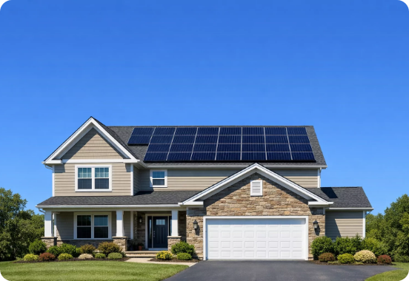
BACKGROUND & CONTEXT
Academic Project Overview
Academic Context
Developed for CSE01 under Problem Solving Using Programming curriculum.
Core Objective
Apply fundamental Java control structures to solve clean energy management challenges.
Team Collaboration
Executed by T. Navya and Vyshali Meesa (Batch 24).

Slide 3



THE CHALLENGE
Problem Statement
Unmonitored Generation
Energy Deficit Risks
Battery Degradation
Solar production fluctuates dynamically without real-time tracking.
Uncontrolled load leads to unexpected power shortfalls.
Lack of charge thresholds causes battery life issues.

Slide 4
SYSTEM GOALS
Objectives & Target Capabilities
100%
3-Tier
Automated
Console Tracking
Battery Range
Daily Report
Real-time solar input validation.
High, medium, and low monitoring.
Complete multi-reading summary.
Enable efficient rooftop energy usage through structured Java logic.

Slide 5
FUNCTIONALITY
Core System Features
1
Record Generated Power
Accept solar generation readings directly through the console.
2
Compare Power Consumption
Calculate exact difference between generated power and consumption.
3
Monitor Remaining Battery
Classify remaining storage into High, Medium, or Low ranges.
4
Generate Daily Report
Output structured reading records using a Java for-loop.

Slide 6
ARCHITECTURE
System Workflow Pipeline
STEP 01
STEP 02
STEP 03
STEP 04
STEP 05
Readings Count
Console Inputs
Calculate Rest
Classify Status
Daily Summary
Set total readings count.
Power, load & battery %.
rest = generated - usage.
Surplus, deficit, balanced.
Final for-loop printout.

Slide 7
PROGRAMMING FOUNDATION
Java Control Structures Applied
while Loop
if – else if – else
Tracks dynamic inputs while reading counter r <= n.
Classifies power balance and battery ranges.
for Loop
Scanner Class
Iterates through stored metrics to print daily reports.
Reads user numeric values seamlessly via System.in.

Slide 8
CODE IMPLEMENTATION
Input & Reading Loop Logic
// Scanner initialization & readings loop
Scanner scn = new Scanner(System.in);
Dynamic Reading Limit
int r = 1;
Accepts total reading count n dynamically from console.
int n = scn.nextInt();
while (r <= n) {
generated_power = scn.nextInt();
Power Difference Calculation
consumption = scn.nextInt();
Computes rest = generated_power - consumption per cycle.
int rest = generated_power - consumption;
}

Slide 9
CORE LOGIC
Energy Balance Classification
SURPLUS
DEFICIT
BALANCED
Power Surplus
Power Deficit
Power Balanced
rest < generated_power
rest > generated_power
rest == generated_power
Generation exceeds consumption. Excess energy stored in battery.
Consumption exceeds solar production. Battery discharge required.
Exact balance between solar energy produced and consumer load.

Slide 10



STORAGE MANAGEMENT
Battery Level Classification
> 80%
50% – 80%
< 50%
High Battery
Medium Battery
Low Battery
Optimal storage level for continuous operational support.
Sufficient reserve capacity, monitor peak consumption.
Critical reserve level. Recommend immediate load reduction.

Slide 11
REPORTING MODULE
Daily Report Generator Logic
Iterative Display
// Consolidated Daily Report for-loop
Leverages a for loop to cleanly format and output all recorded solar metrics.
for (int i = 0; i < n; i++) {
System.out.println("Reading " + (i+1) + ":");
System.out.println("Power Generated: " + generated_power + " W");
System.out.println("Consumption : " + consumption + " W");
System.out.println("Battery : " + battery + "%");
Formatted Output
System.out.println("Conclusion: " + conclusion);
}
Presents power units in Watts (W) and battery levels as exact percentages (%).

Slide 12
EXECUTION
Sample Console Execution Trace
> Enter no. of readings: 3
Reading 1 Result
[Reading 1] 87W Gen | 67W Cons | 89% Battery
Sufficient generation (+20W surplus) and optimal storage (89%).
→ Output: Surplus --- high battery
[Reading 2] 85W Gen | 89W Cons | 34% Battery
→ Output: Surplus --- low battery
Reading 2 & 3 Result
Tracks dynamic changes across energy levels and battery ranges.
[Reading 3] 45W Gen | 67W Cons | 78% Battery
→ Output: Surplus --- medium battery

Slide 13
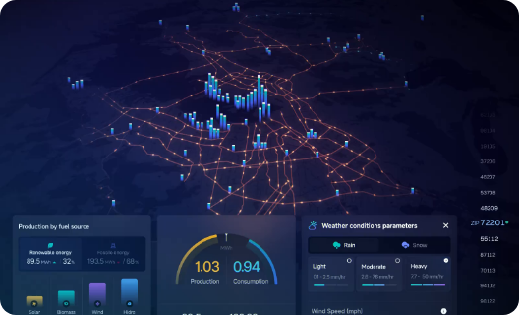
OUTPUT ANALYSIS
Daily Report Output Format
=== DAILY REPORT ===
Reading 1:
87W Gen / 67W Load / 89% Batt
Reading 2:
85W Gen / 89W Load / 34% Batt
Reading 3:
45W Gen / 67W Load / 78% Batt

Slide 14
LEARNING OUTCOMES
Project Achievements & Takeaways
Control Flow Mastery: Successfully applied while, for, and if-else logic in a real-world scenario.
Clean Energy Modeling: Structured dynamic data handling for generation and consumption metrics.
Console UI Design: Delivered clear and scannable daily reporting formatting.
Extensible Foundation: Ready for future GUI and real-time solar IoT sensor integration.

Slide 15


Thank You!
Rooftop Solar Energy Monitor • Java Problem-Solving Project

